Slide 1
Computer Science Project I – CS691 FinAssist - a revolutionary step
GUIDANCE BY – PROF HENRY WONG
Team Members
1. Chinmay Deshpande 2. Rohan Raygade
3. Ankit Mohokar 4. Shivani Gade
5. Sayali Khare
Our Wiki Link –
https://github.com/gadeShivani/FinAssist/wiki

Slide 2
Introduction -
FinAssist , which will solve financial queries of the customers using Chatbot and will implement blockchain technology to commit money transactions on the go.
The use of AIML and NLP makes the chatbot understand what the user is asking and use of AI and Deep Learning to enforce it, makes the bot train itself and learn user-specific information.
Implementation of a Chatbot and Blockchain in financial industry.
Chatbot
Blockchain
Reporting Analysis
Forecasting

Slide 3
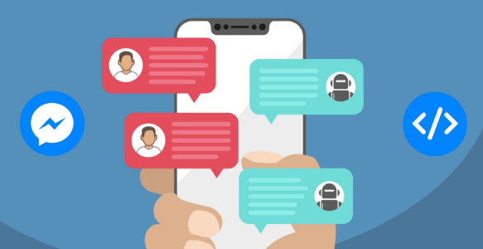
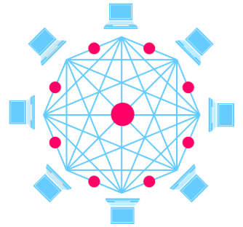
Timeline -
Phase I : Chatbot
Technology review and research
Industry type (Finance)
Requirement Analysis
Implementation
Phase II : Block Chain
Technology review and research
Industry type (Finance)
Requirement Analysis
Implementation
User Experience
Deployment

Slide 4
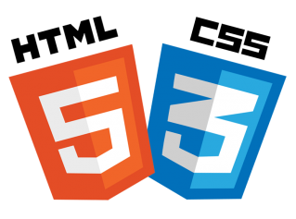
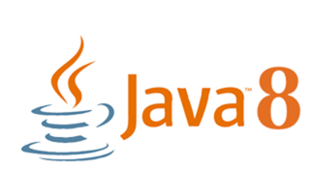


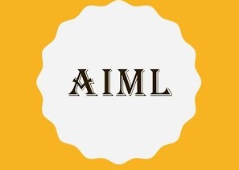
Requirements -

Slide 5
Objectives -
Chatbot
Smart bots are mobile optimized out of the box.
Strength in a personal money management assistant provided with smart bot services.
Attract millennial customers by talking on their terms.
Smooth Customer Support.
Increase User Engagement
Blockchain
Instant Settlements.
Improve Capital Optimization.
Reduced third-party Risks.
Increased Transparency
Reduced Error Handling and Reconciliation

Slide 6
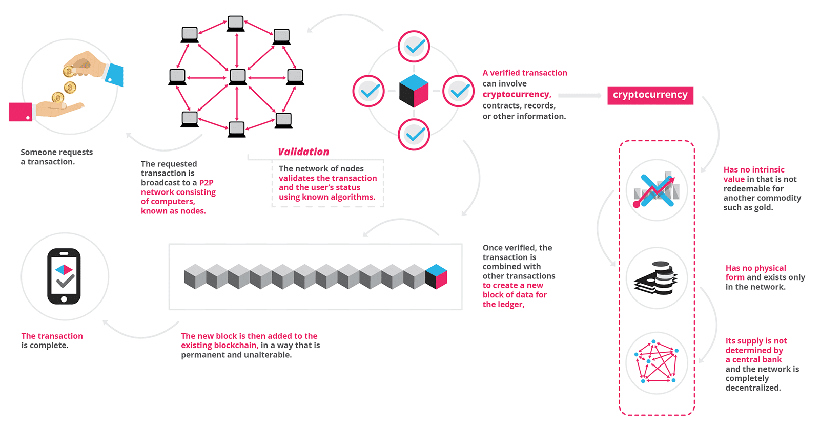
Blockchain -
Blockchain is a distributed database solution which maintains a constantly updating list of data records, where the incoming data is confirmed and acknowledged by every nodes that are participating in it.
Offering the biggest generation piece chain stage on the planet, Blockchain is utilizing new innovation to manufacture a drastically better monetary framework.

Slide 7
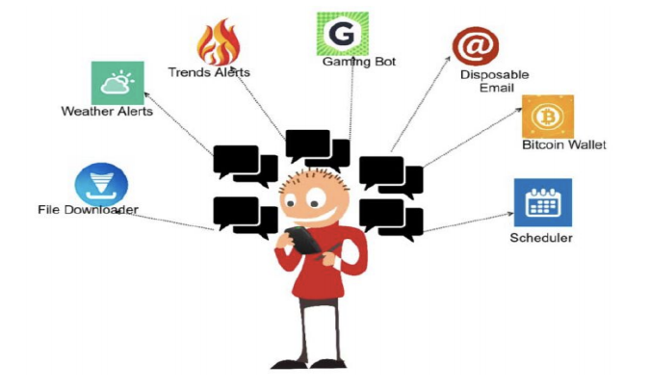
Chatbot -
Computer Program which simulates human conversation or chat using Artificial Conversation.
Our chatbot will help financial service providers acquire & retain customers thanks to AI-powered conversations.

Slide 8
Breakdown -
JANUARY
Researched about chatbot, blockchain and its application.
FEBRUARY
Requirement Gathering.
MARCH
Front end development.
APRIL
Implementation of Chatbot using Java and AIML.
MAY
Merging of Project.

Slide 9
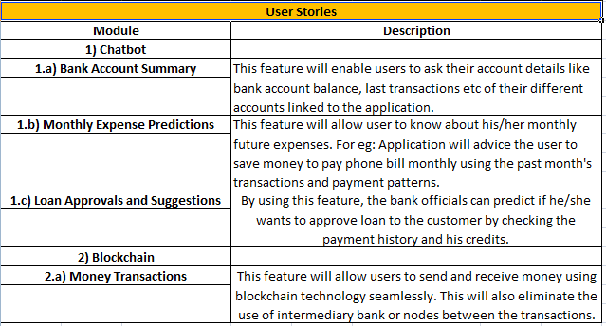
User Stories -

Slide 10
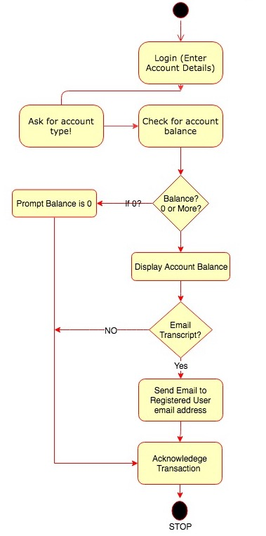
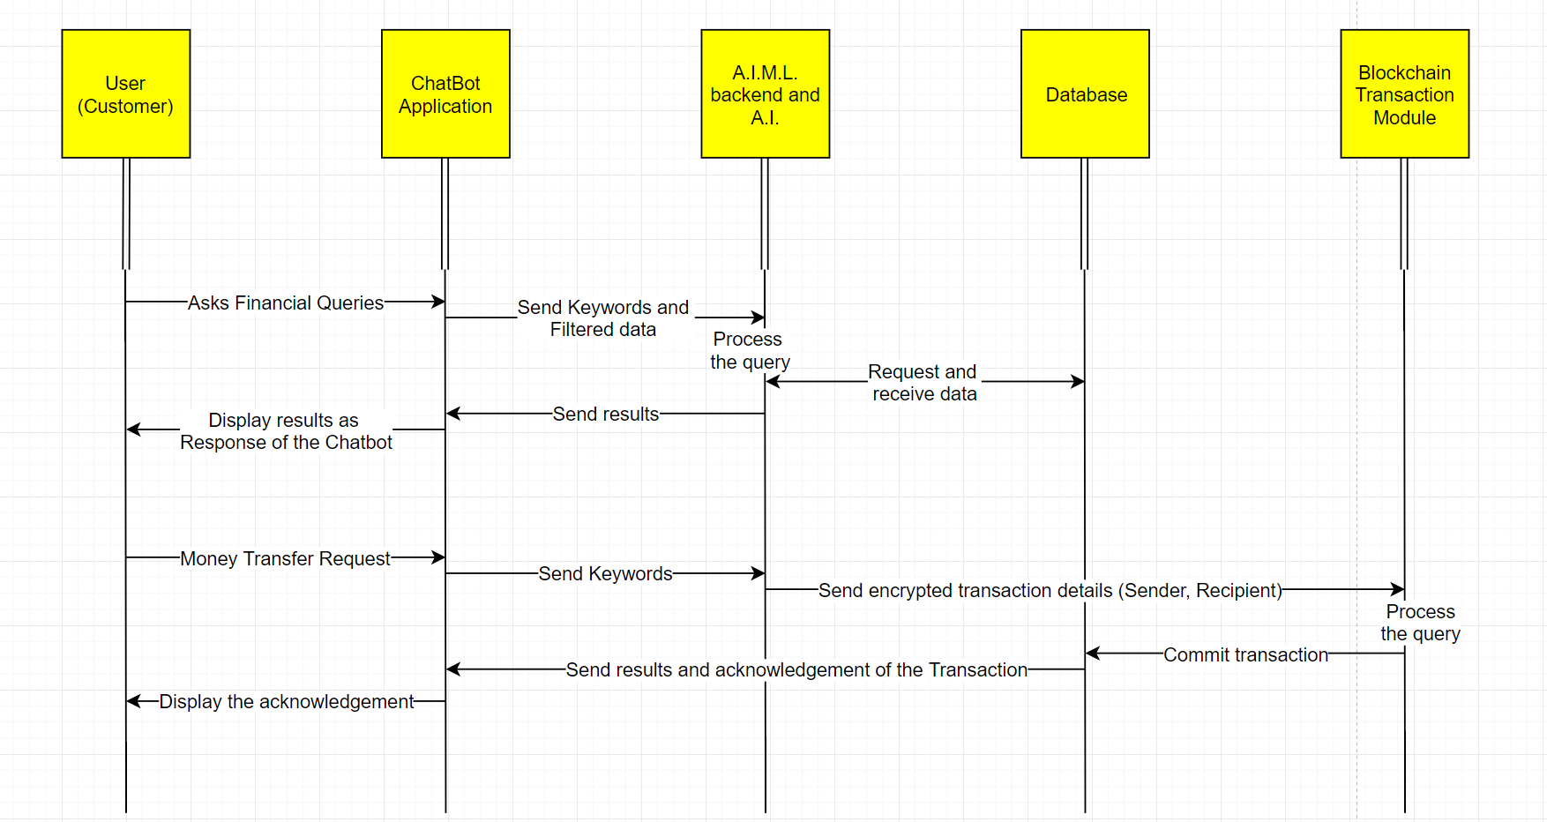
Diagrams -

Slide 11
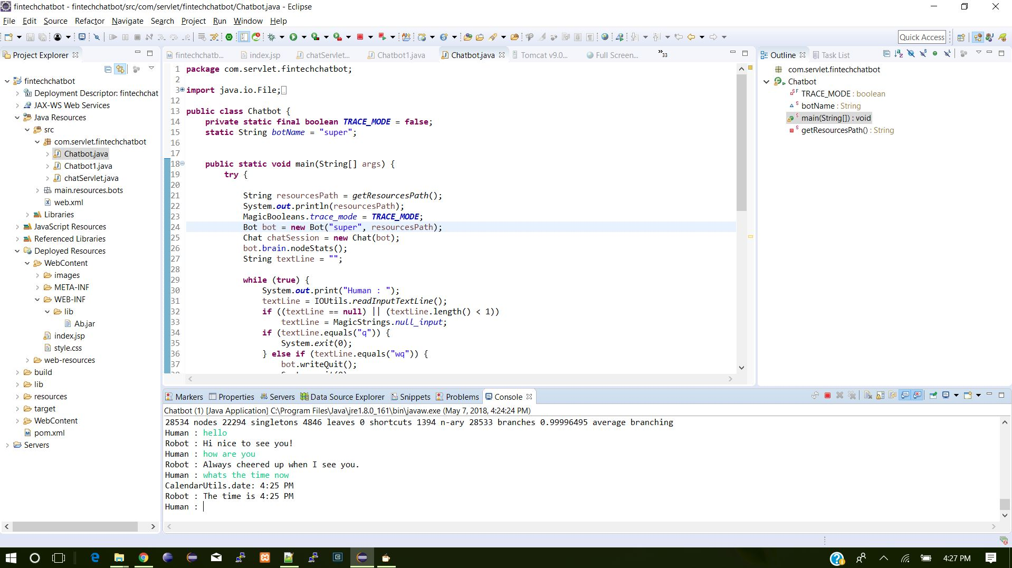
Chatbot Implementation -

Slide 12
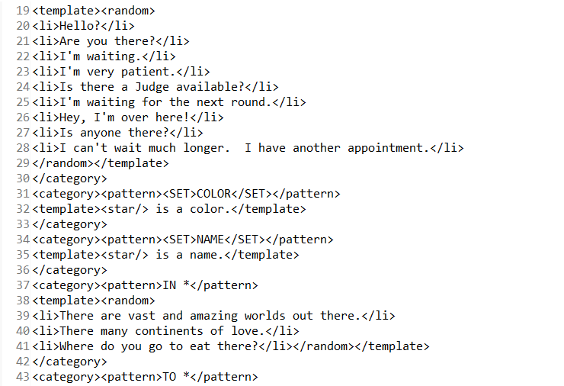
AIML Natural Language Processing -

Slide 13
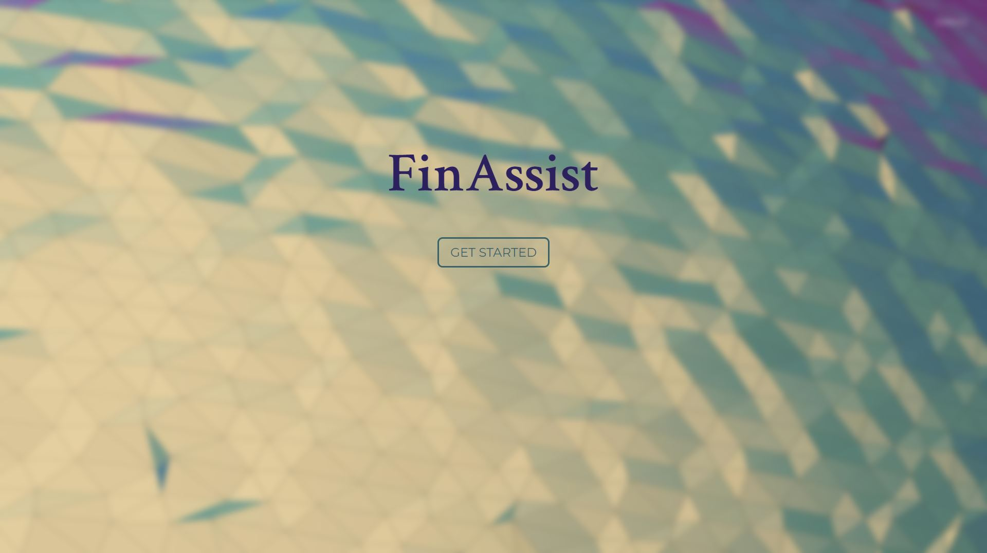
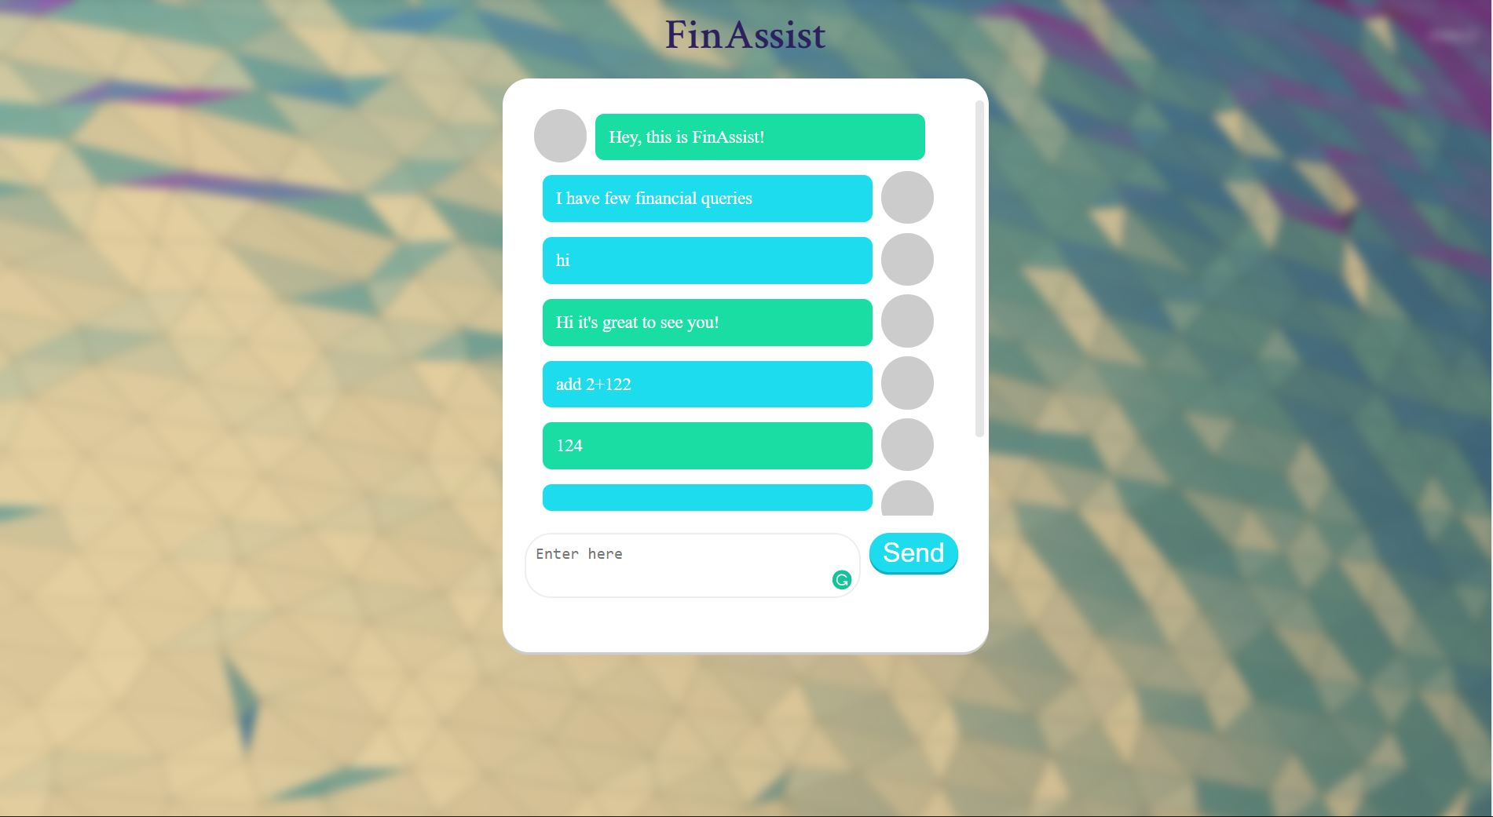
Frontend Implementation -

Slide 14
Future Plan -
We will be implementing blockchain technology to commit money transactions between the users.
Blockchain is a technology which maintains distributed ledgers, a digital.
We will also implement the chatbot application for android.
This enables user to interact with bot and transact money anonymously by maintaining global states.

Slide 15
Thank You….

